Slide 1
HTML-introduction
Basic of the HTML files

Slide 2
SUMMARY
Core Elements:
Titles – Define page titles.
Paragraphs – Separate text into blocks.
Lists – Create ordered and unordered lists.
Links (Anchors) – Enable navigation between pages.
Images – Embed visuals with src and alt attributes.
Attributes – Provide additional element information.
Paths – Specify file locations (absolute/relative).
Tools & Best Practices:
Use VS Code with Live Preview.
Close all tags properly and keep code readable.
Validate HTML to ensure compatibility and accessibility.
Final Project:
Build a basic HTML structure for a DIY Workshop Management System.
Include forms, navigation, inventory tables, and realistic data.
Upload to GitHub as craftease-workshop-management.

Slide 3
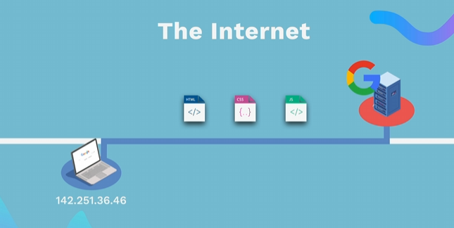
HOW WEBSITES WORK
HTML (Content) - The structure of a web page (text, images, buttons). CSS (Styles) - Defines the layout (colors, fonts, arrangement of elements). JavaScript (Functionality)- Adds interactivity (click events, animations, form validation). The browser interprets and displays these files to display the web page.
www.appbrewery.com
Notes:
• Emphasize that HTML is mandatory for any web page and serves as the structural foundation on which CSS and JavaScript build design and interactivity. • Open with a discussion on how browsers parse these three components to render a complete webpage. • Consider demonstrating a simple “Hello World” HTML file in Visual Studio Code with Live Preview.
Resources: • https://developer.mozilla.org/en-US/docs/Web/HTML for a thorough introduction. Additional Reading: • HTML and CSS: Design and Build Websites by Jon Duckett • Learning Web Design: A Beginner’s Guide to HTML, CSS, JavaScript, and Web Graphics by Jennifer Niederst Robbins

Slide 4
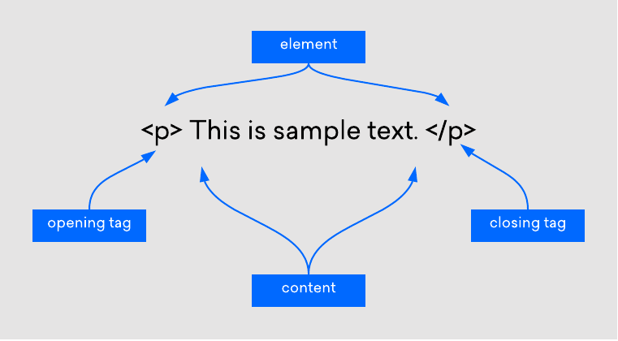
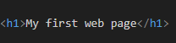
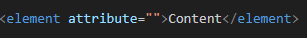
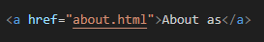
HTML
Unlike CSS or JavaScript, a website can only exist with an HTML file Markup language: Similar to editorial markup in manuscripts (bold, underline, etc.) HTML uses tags to structure content
www.w3schools..com
Notes:
Teacher Notes: • Clarify that while CSS and JavaScript enhance user experience, HTML is indispensable for content. • Use side-by-side examples to show a page with only HTML versus one with additional CSS and JavaScript. • Discuss how changes in each part (structure, style, behavior) affect the final rendered page.
Resources: • MDN – Introduction to HTML - https://developer.mozilla.org/en-US/docs/Learn_web_development/Core/Structuring_content/Basic_HTML_syntax Additional Reading: • HTML and CSS: Visual QuickStart Guide by Elizabeth Castro

Slide 5
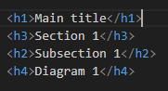
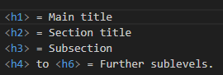
HTML TITLES

Slide 6
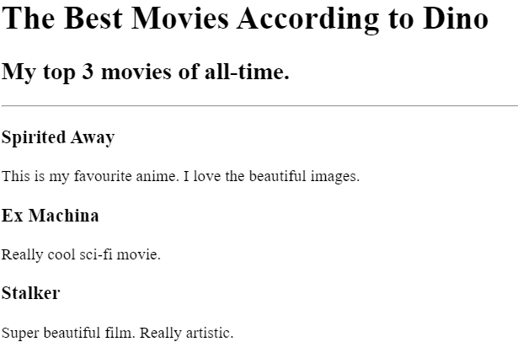
HTML TITLES – EXERCISE 1
Install in VS code and use the Live Preview plugin to view changes in real-time Recreate image
Notes:
Teacher Notes: • Demonstrate setting up VS Code with the Live Server extension to observe changes instantly. • Explain the role of the <title> tag not only in SEO but also in user navigation (browser tabs). • Walk through creating an HTML document that uses a proper <head> section including a title.
• Exercise estimation time: 20 min / individual
Resources: • MDN – Using the HTML <title> element
Code - https://github.com/dinoDuvnjak/CTK/tree/main/SHIFT4IT/html-introduction/2.6-html-final

Slide 7
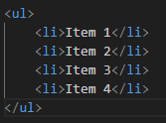
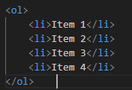
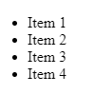
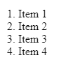
HTML LISTS
Unordered list
Ordered list
It is used when the order is not important (e.g. shopping list).
It is used when the order is not important (e.g. shopping list).
Notes:
Teacher Notes: • Stress the importance of correct syntax and indentation for both maintenance and readability. • Conduct a live coding session to show how HTML lists should be structured and highlight typical errors.
Resources: • MDN – HTML Lists • W3Schools – HTML Lists
Additional Reading: • Learning Web Design by Jennifer Niederst Robbins

Slide 8
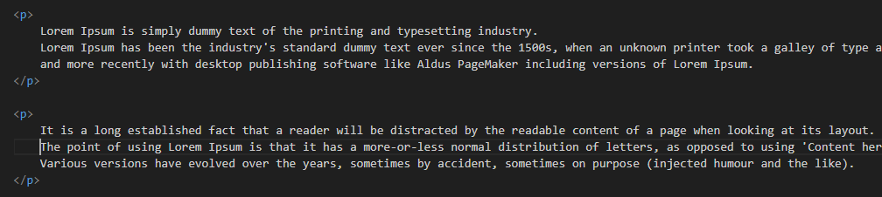
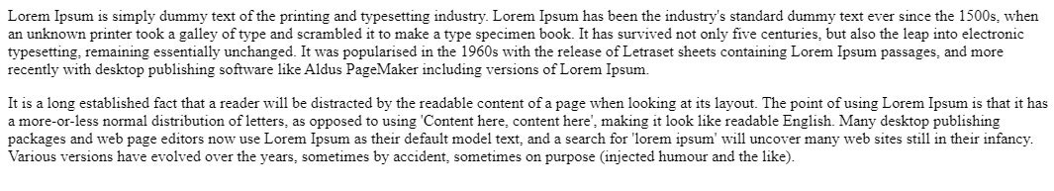
HTML PARAGRAF
💡 The paragraph element<p> is used to format the text into separate paragraphs 👉 Without <p> tags, all the text would be in one long block. 👉 It separates the text and adds visual spacing between paragraphs. 👉 Screen readers use <p> labels to help visually impaired users navigate through text
Notes:
Teacher Notes: • Illustrate how omitting <p> tags can lead to cluttered content and poor accessibility. • Discuss best practices in creating readable content that both sighted users and screen readers can navigate easily.
Resources: • MDN – HTML Paragraphs
Additional Reading: • Accessibility for Everyone by Laura Kalbag

Slide 9
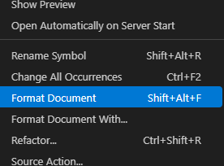
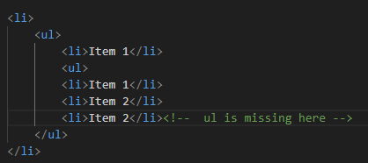
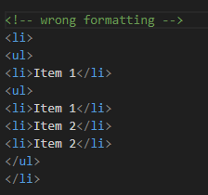
HTML LISTS
Common mistakes to avoid Forgetting to close tags (</ul> or </ol>).
Incorrect code indentation, making it difficult to read and maintain.
Setting </li> before closing a nested list instead of after it.

Slide 10
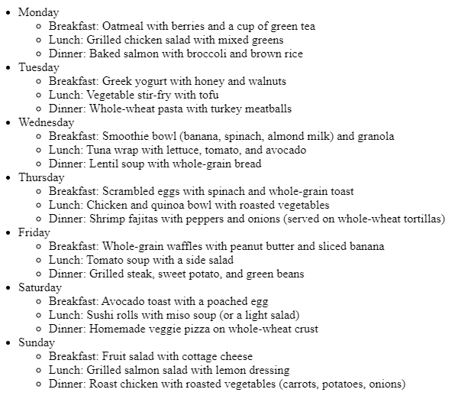
HTML LIST – EXERCISE 2
Recreate image in html code
Notes:
Teacher Notes: • Guide students through the creation of nested lists and using proper list tags (<ul>, <ol>, <li>). • Offer step-by-step instructions while projecting the code and its rendered output.
• Exercise estimation time: 20 min / individual
Resources: • MDN – HTML Lists • W3Schools – HTML Lists
Code - https://github.com/dinoDuvnjak/CTK/tree/main/SHIFT4IT/html-introduction/2.2-html-list

Slide 11
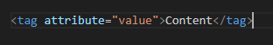
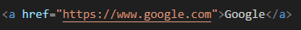
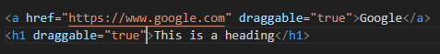
HTML ATTRIBUTES
HTML elements can have attributes that add additional information about the element. Attributes are located inside the opening tag
Specific
Global
Notes:
Teacher Notes: • Explain that attributes add metadata or control behavior for HTML elements (e.g., href, src, alt). • Discuss how some attributes are available for all tags (global attributes) while others are tag-specific. • Encourage students to explore the provided link for interactive examples.
Resources: • W3Schools – HTML Attributes • MDN – HTML Standard Attributes
Additional Reading: • HTML5 in Easy Steps by Mike McGrath

Slide 12
HTML ANCHOR
- Allows the creation of hyperlinks - The href attribute specifies the URL to which the link leads.
- Attributes are located inside the opening tag - Without the href attribute, the link is not active
Notes:
Teacher Notes: • Demonstrate the creation of both internal and external links using relative and absolute URLs. • Highlight the importance of using descriptive link text for both SEO and accessibility.
Resources: • MDN – The HTML Anchor Element • W3Schools – HTML Links

Slide 13
HTML IMAGE
- Allows you to add images to our websites - The src attribute (source) defines the source of the image <img> It doesn't have a closing tag, because it's a void element.
Why is alt important? - Helps blind and visually impaired people understand the content of the image. - When an image can't load, alt text is displayed.
Notes:
Teacher Notes: • Emphasize best practices for image embedding and the critical role of the alt attribute in accessibility. • Show examples of responsive images and discuss troubleshooting steps if images do not load.
Resources: • MDN – The HTML <img> Element • W3Schools – HTML Images

Slide 14
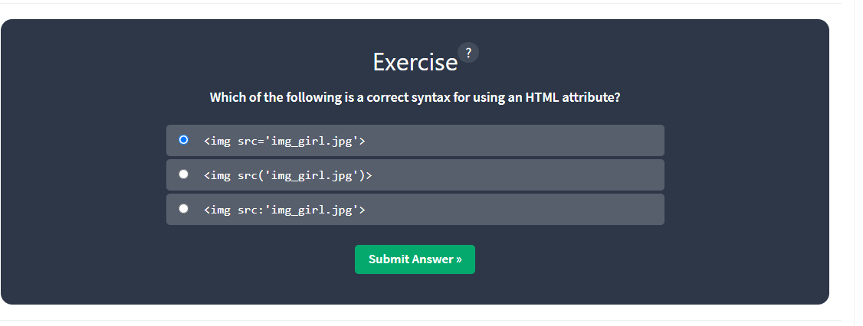

HTML ATTRIBUTES – EXERCISE 3
- Go to ://www.w3schools.com/html/html_attributes.asp and practice the quiz
Notes:
Teacher Notes: • Briefly review common pitfalls with attributes in class after the exercise. • Encourage students to modify attributes and observe changes in real-time using a code editor.
• Exercise estimation time: 15 min / individual
Resources: • W3Schools – HTML Attributes

Slide 15
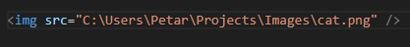
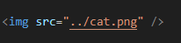
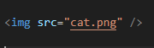
HTML PATHS
- A file path is a unique location on your computer where a specific file or folder is located. - We can compare it to a real-world address
Absolute path
Relative path
One level up
Current directory
Notes:
Teacher Notes: • Use examples to illustrate the differences between absolute and relative paths. • Demonstrate navigation using relative path syntax in linking files locally.
Resources: • MDN – URLs, URIs, and URNs • W3Schools – How Paths Work
Additional Reading: • Responsive Web Design with HTML5 and CSS3 by Ben Frain

Slide 16
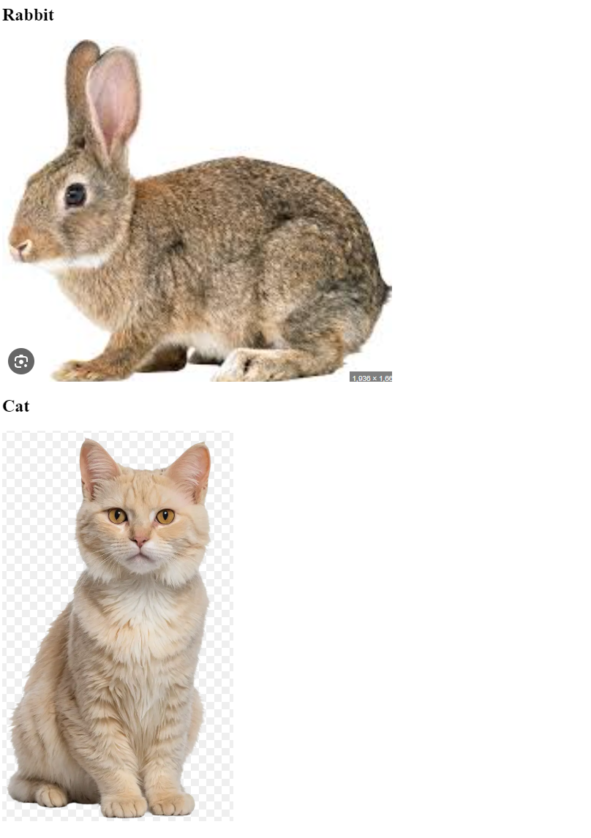
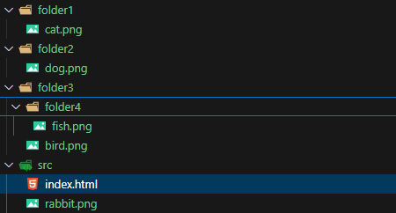

HTML IMAGES – EXERCISE 4
- Download 2.4-html-image-link project and connect the images in html file
- Replicate the image result
Notes:
Teacher Notes: • Walk through the process of linking local images and discuss troubleshooting common issues like incorrect file paths or typos. • Offer to review a sample project live, explaining the impact of each attribute used in the <img> tag.
• Exercise estimation time: 25 min / individual
Resources: • W3Schools – HTML Images Tutorial • MDN – The HTML <img> Element
Code - https://github.com/dinoDuvnjak/CTK/tree/main/SHIFT4IT/html-introduction/2.4-html-image-link

Slide 17
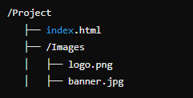
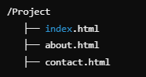
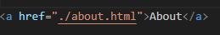
HTML MULTIPAGE
- To allow users to navigate through the site, we need to link pages using hyperlinks.
One page website
Multipage website
How to link a page
- Allows you to add images to our websites - ./ means "search in the current directory". - By clicking on the link, we will be taken to the "About Us" page.
Notes:
Teacher Notes: • Demonstrate linking multiple HTML files to create a navigable website. • Emphasize the importance of organizing files and folders for maintainability. • Use a live coding example to show how clicking a link opens a new page.
Resources: • MDN – Linking to Other Resources • W3Schools – HTML Links
Additional Reading: • Head First HTML and CSS by Elisabeth Robson and Eric Freeman

Slide 18
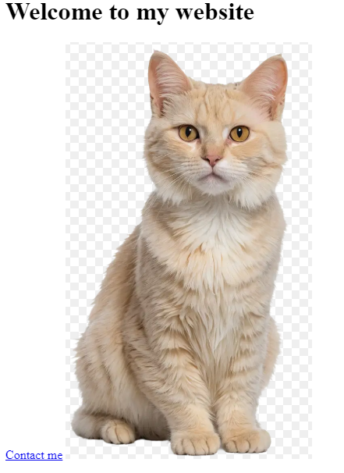
HTML LINKS – EXERCISE 5
Create a multi-page site - Clicking on the image takes us to the about us page - Click on Contact me, take us to the contact page
Notes:
Teacher Notes: • Provide clear guidelines and a rubric for the exercise. • Encourage students to test all navigation links to ensure there are no broken paths. • Review best practices for organizing and maintaining consistent navigation across pages.
Resources: • Codecademy – Building Multi-Page Websites (project-based learning) • MDN – Hyperlink Fundamentals
Code - https://github.com/dinoDuvnjak/CTK/tree/main/SHIFT4IT/html-introduction/2.5-html-multipage-website

Slide 19
HTML – FINAL EXERCISE
Objective
Create a basic HTML skeleton for CraftEase, a DIY Workshop Management System designed for home improvement retailers. The goal is to create a foundation that will later be enhanced with CSS and JavaScript to provide a complete digital service for managing DIY workshop registrations, project tutorials, and tool/material availability tracking. Once completed, upload the project to GitHub.
Project Background
Header with site branding and description
Navigation menu for different system sections
Workshop Registration Form for new participants
Participant Management Table showing registered customers
Upcoming Workshops Section displaying scheduled events
Tool & Material Inventory Table for availability tracking
Notes:
Teacher Notes: • Clearly lay out project requirements and milestones. • Provide a sample file structure and tips on ensuring clean, indented code. • Encourage peer reviews and code sharing via GitHub to promote collaborative learning. • Highlight the importance of version control in web development.
• Exercise estimation time: 30 min / individual
Resources: • GitHub Guides – Hello World for an introduction to Git and GitHub • FreeCodeCamp – HTML Project Tutorials for project-based learning
Code- https://github.com/dinoDuvnjak/CTK/tree/main/SHIFT4IT/html-introduction/2.6-html-final

Slide 20
HTML – FINAL EXERCISE
Content Requirements
Add at least four sample workshop participants with realistic data
Include five different workshop types (woodworking, electrical, plumbing, tile installation, painting)
Show two upcoming workshop cards with complete details
Display four inventory items with stock levels and availability status
Use appropriate form elements (text inputs, selects, textarea, email, tel, number)
Deliverables
HTML file named index.html with complete workshop management system structure
README.md file explaining the project purpose and structure
GitHub repository with the complete project uploaded
Ensure the HTML validates and displays properly in modern browsers
Submission
Upload your completed project to GitHub with:
Repository name: craftease-workshop-management
Include all required files (HTML, README.md)
Notes:
Teacher Notes: • Clearly lay out project requirements and milestones. • Provide a sample file structure and tips on ensuring clean, indented code. • Encourage peer reviews and code sharing via GitHub to promote collaborative learning. • Highlight the importance of version control in web development.
• Exercise estimation time: 30 min / individual
Resources: • GitHub Guides – Hello World for an introduction to Git and GitHub • FreeCodeCamp – HTML Project Tutorials for project-based learning
Code- https://github.com/dinoDuvnjak/CTK/tree/main/SHIFT4IT/html-introduction/2.6-html-final

Slide 21
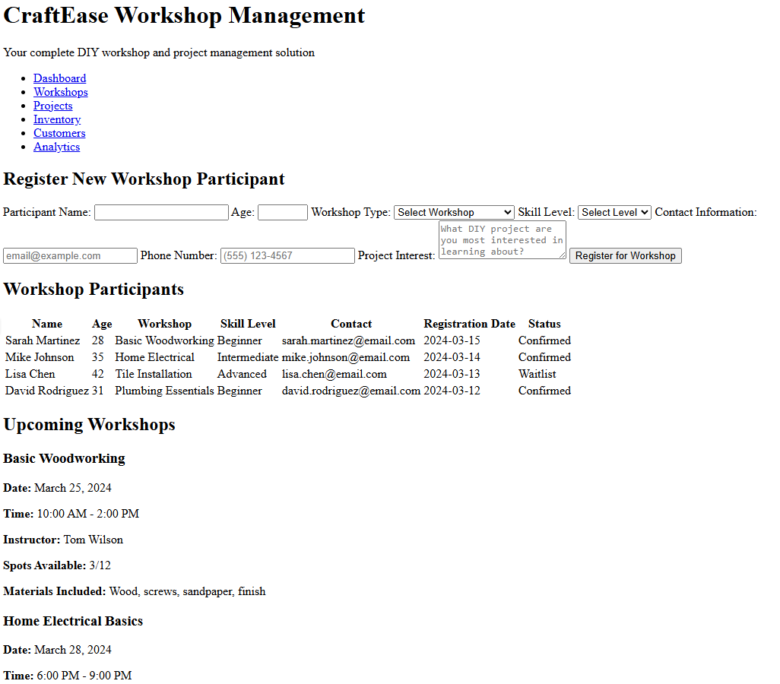
HTML – FINAL EXERCISE
Notes:
Teacher Notes: • Clearly lay out project requirements and milestones. • Provide a sample file structure and tips on ensuring clean, indented code. • Encourage peer reviews and code sharing via GitHub to promote collaborative learning. • Highlight the importance of version control in web development.
Resources: • GitHub Guides – Hello World for an introduction to Git and GitHub • FreeCodeCamp – HTML Project Tutorials for project-based learning
Code- https://github.com/dinoDuvnjak/CTK/tree/main/SHIFT4IT/html-introduction/2.6-html-final

Slide 22
HTML and CSS: Design and Build Websites by Jon Duckett - Learning Web Design: A Beginner’s Guide to HTML, CSS, JavaScript, and Web Graphics by Jennifer Niederst Robbins
Responsive Web Design with HTML5 and CSS3 by Ben Frain
Learning Web Design by Jennifer Niederst Robbins
HTML and CSS: Visual QuickStart Guide by Elizabeth Castro
- Head First HTML and CSS by Elisabeth Robson and Eric Freeman

Slide 23
https://developer.mozilla.org/en-US/docs/Web/HTML
https://developer.mozilla.org/en-US/docs/Learn_web_development/Core/Structuring_content/Basic_HTML_syntax
https://developer.mozilla.org/en-US/docs/Web/HTML/Reference/Elements/title
https://www.google.com/search?q=MDN+%E2%80%93+HTML+Paragraphs&ie=UTF-8
https://developer.mozilla.org/en-US/docs/Web/HTML/Reference/Elements/p
https://developer.mozilla.org/en-US/docs/Learn_web_development/Core/Structuring_content/Lists
https://www.w3schools.com/html/html_attributes.asp
https://developer.mozilla.org/en-US/docs/Learn_web_development/Core/Structuring_content/Creating_links
https://developer.mozilla.org/en-US/docs/Web/HTML/Reference/Elements/img
https://developer.mozilla.org/en-US/docs/Web/HTML/Reference/Elements/link
https://developer.mozilla.org/en-US/docs/Learn_web_development/Core/Structuring_content/Creating_links

